Slide 1
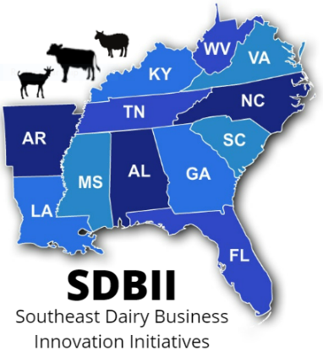
Southeast Dairy Business Innovation Initiatives Specialty Processing Equipment & Dairy Business Planning Grants

Slide 2
What is the SDBII?
Southeast Dairy Business Innovation Initiative (DBII)
– Supported by USDA AMS
– Over $38MM effort, 50% spent on dairy business subawards
• Goal is to support value added dairy production in the SE
•Supports value-added dairy in states including Alabama, Arkansas, Florida, Georgia, Kentucky, Louisiana, Mississippi, North Carolina, South Carolina, Tennessee, Virginia, West Virginia, and Puerto Rico
– Also, in MW and NE through companion programs
• Focus is on projects that manufacture milk supply into “value-added” products

Slide 3
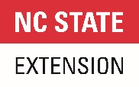

Slide 4
What is the purpose of SDBII Business Grants?
● Diversify dairy product markets to reduce risk and develop
higher-value uses for dairy products.
● Promote business development that diversifies farmer income through processing and marketing innovation.
● Encourage the use of regional milk production.

Slide 5
Who Can I Reach Out to for Help?
Program Contacts
Tennessee, Alabama, Florida, & Louisiana
Shep Stearns & Liz Eckelkamp: sdbiigrants@utk.edu
Kentucky, Arkansas, Virginia, & West Virginia
Jennifer Hickerson: j.hickersonkddc@gmail.com
North Carolina, South Carolina, Georgia, & Mississippi
Brittany Whitmire & Stephanie Ward: ncdairyextension@ncsu.edu

Slide 6
Who can apply?
SDBII funding is open to businesses in states including Alabama, Arkansas, Florida, Georgia, Kentucky, Louisiana, Mississippi, North Carolina, South Carolina, Tennessee, Virginia, West Virginia, and Puerto Rico
Applicants Must Either:
Operate a permitted dairy farm
Operate a permitted dairy processing facility

Slide 7
What Grants are Currently Available?
The RFP and Grant Application are available for two grant opportunities right now:
Specialty Processing Equipment Grant
https://sdbii.tennessee.edu/specialty-equipment-processing-grant/
Dairy Business Planning Grant
https://sdbii.tennessee.edu/dairy-business-planning-grant-open/

Slide 8
Purpose of Specialty Processing Equipment Grant:
• Value chain and commodity innovation
– New products, new ways to use milk
• Facility and process updates for dairy processors
– Specialized equipment involved in processing milk
• Product development, packaging and marketing of dairy products
– Limited runs, test batches for new products, new packaging, etc.

Slide 9
Specialty Processing Equipment Grant
Award Funding Available:
$300,000 maximum award
$1.92MM is available to award
At least 6 grants will be awarded.
The Specialty Processing Equipment Grant is competitive, and only the highest quality grants will be selected for an award of funding.

Slide 10
Allowable Costs Specialty Processing Equipment Grant
• Specialized milk processing equipment
• Marketing plans
• Certain marketing or promotional
activities or materials
– Limited Runs
– Test Marketing

Slide 11
Unallowable Costs
• Real estate purchases
• Repayment of loans or mortgages
• Rent or contract payments for time periods extending beyond the
12-month period allowed for eligible projects
• Legal fees (for suits, disputes, etc.)
• Lobbying, fundraising, or other political activities

Slide 12
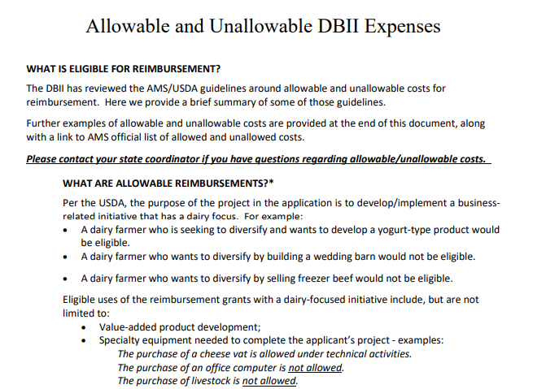
Allowable and Unallowable Expenses
https://www.ams.usda.gov/sites/default/files/media/AMSGrantsTermsandConditions.pdf

Slide 13
Allowable Costs Specialty Processing Equipment Grant
The focus on the project must be on purchasing processing equipment to:
Produce new products
Increase capacity
Increase efficiency

Slide 14
Example Projects Specialty Processing Equipment Grant
Examples of eligible projects:
A project to fund the purchase of a vat pasteurizer to create a new line of flavored milks.
A project to fund the purchase of a cream separator to produce cream products.
A project to fund the purchase of a new cheese drain table to increase capacity of cheese production.

Slide 15
Specialty Processing Equipment Grant
Match Requirement:
Applicants must provide a cash match of at least 25% of the requested grant funds. For instance, a grant application requesting $100,000 would require $25,000 in matching expenses. Please note that a 25% match on requested funds is the same as 20% of the total project cost. To illustrate this, we can see that $25,000 (the match) equals 25% of $100,000 (the request), and 20% of $125,000 (the total project cost). Must be allowable expenses.
SDBII Grant Funds
Your Cash Match
$1
25

Slide 16
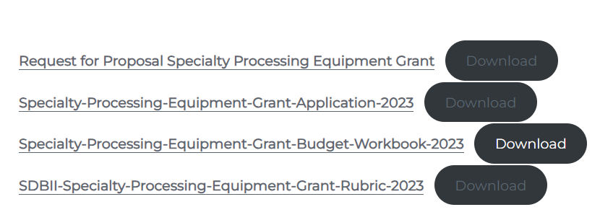
Grant Workbook Components
Please read the request for proposal IN FULL before starting your application.

Slide 17
Dairy Business Planning Grant
Dairy Business Planning Grant:
$30,000 max award
No match required
$250,000 available
At least 8 awards are expected to be made

Slide 18
Allowable Costs Dairy Business Planning Grant
Leveraging the experience and judgment of reputable industry experts to evaluate the feasibility of a proposed new enterprise, business/marketing approach, process, or major investment
Increasing the applicant's working knowledge of their existing business and/or future enterprise
Gaining a certification, credit, and/or educational experience that improves the competitiveness of the business or its workforce
Utilizing legal services to strengthen the business structure or succession plan

Slide 19
Example Projects Dairy Business Planning Grant
A dairy farm conducts a feasibility study exploring the viability of starting an on-farm creamery with the help of a qualified and experience consultant
A producer-processor dairy business hires a lawyer to draft a new set of company bylaws
A dairy farm hires a certified crop advisor to plan a transition to feeding a high forage diet
A dairy business hires an agricultural business consultant to assist in drafting a business plan
A group of cheese makers pay to attend a short course to improve their cheese-making skills
A milk processor pays a food scientist to develop/update a food safety plan

Slide 20
Scoring Criteria
The grant is scored out of a possible 100 points based on the following categories
Grant Application (5 possible points)
Goals Alignment (10 possible points)
Summary (20 possible points)
Work Plan (20 possible points)
Business Fundamentals (20 possible points)
Budget (20 possible points)
Other Considerations (5 possible points)

Slide 21
How do I access/submit the grant?
First read the grant RFP IN FULL
Reach out with questions to one of your state coordinators
Download and save the application to your computer
Work in word or another word processing program (save as you go!)
Transfer to the application when you are done
Email your completed application to sdbiigrants@utk.edu
Applications must be received by: October 16, 2023, at 3:00 pm

Slide 22
Unique Entity Identifier
Written Guide:
For nearly all of the opportunities discussed today you will need a UEI from SAM.GOV
Written Guide:
Click tab above the video: https://www.tn.gov/agriculture/topic/farm.html
Video Guide:
https://www.youtube.com/watch?v=0uv1YNAsINk

Slide 23
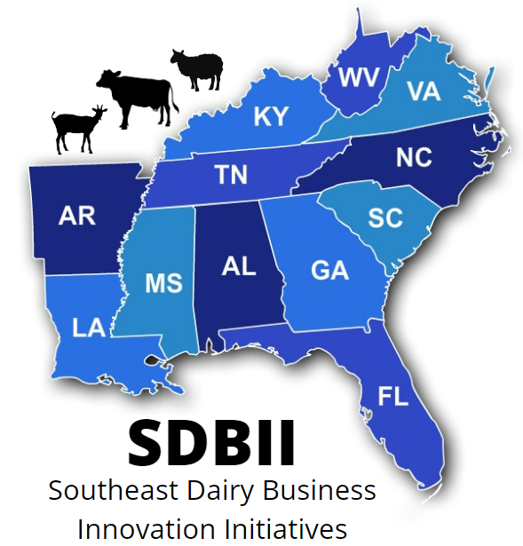
Thank you! Questions?
Shep Stearns
sstearn1@utk.edu
(860) 595-6053
Southeast Value-Added Discussion Group
https://sdbii.tennessee.edu/

