Slide 1
Southeast Dairy Business Innovation Initiatives (SDBII) Farm Business Grants

Slide 2
What is SDBII?
Southeast Dairy Business Innovation Initiative (SDBII)
– Supported by USDA AMS
– Over $38MM effort, 50% spent on dairy business subawards
•Supports dairy businesses in the Southeast
– Also, in West, Mid-West, and Northeast through companion DBII programs

Slide 3
SDBII: Research and Technical Assistance
Program encompassing:
Animal husbandry
Large ruminant
Small ruminant
Food safety
Food quality & product development
Economic evaluation and benchmarking
Farm
Processing
Emerging issues (policy, transportation)
Marketing and Agritourism

Slide 4
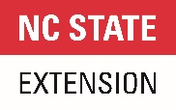

Slide 5
Grant Programs
Spring Cycle: Open - January 5; Closes – March 1 at 5pm/ET
Farm Infrastructure Improvement Grant (inaugural program in 2022)
Focus on improving existing dairy farm businesses through cow comfort, stall improvements, cooling and ventilation improvements, etc.
Precision Technology and Management Grant (inaugural program in 2022)
Focus on investing in precision technologies or management tools for existing dairy farm businesses such as robotic milking, automated calf feeders, behavior monitoring technologies, etc.
Fall Cycle:
Dairy Business Planning Grant (inaugural program in 2020)
Open to all dairy businesses, both processing and farm
Specialty Processing Equipment Grant (inaugural program in 2020)
Focus is on adding or updating equipment for dairy processing facilities

Slide 6
What is the purpose of SDBII Business Grants?
Spur growth and profitability for dairy producers and processors in the Southeast by helping them modernize and innovate

Slide 7
Who can apply?
Applicants Must Either:
Operate a permitted dairy farm
Operate a permitted dairy processing facility

Slide 8
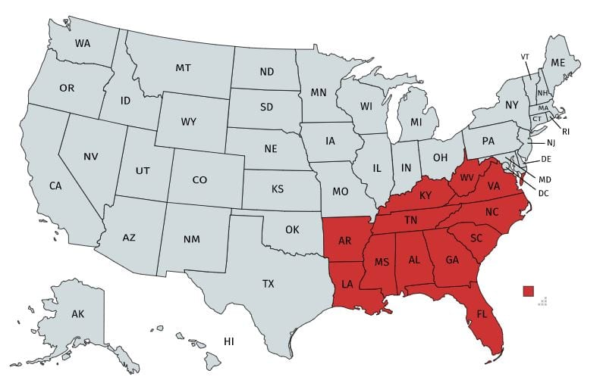
Program Reach
Alabama
Arkansas
Florida
Georgia
Kentucky
Louisiana
Mississippi
North Carolina
South Carolina
Tennessee
Virginia
West Virginia
Puerto Rico

Slide 9
Dairy Business Grants Awarded
Total: 107
Grant Type | Number Awarded
Dairy Business Planning | 9
Specialty Processing Equipment | 39
Farm Infrastructure Improvement | 44
Precision Technology & Management | 15

Slide 10
Farm Infrastructure Improvement Grant:
Maximum Award Amount: $100,000 per Grantee
Matching Funds on Request: 25% of Requested Amount (e.g., $25,000 on a $100,000 request)
$1,000,000 available to award; At least 10 awards are expected to be made.

Slide 11
Farm Infrastructure Improvement Grant
Implementation or upgrading of cooling systems/ventilation to reduce heat stress
Increasing water and feed access
Investing in equipment to increase parlor throughput and labor efficiency
Improved feed and forage management and storage
Improvements to animal housing and environments
Water, waste, and manure management improvements
Investing in more efficient on-farm milk cooling and/or storage

Slide 12
Precision Technology Investment Grant:
Maximum Award Amount: $150,000 per Grantee
Matching Funds on Allowable Expenses: 25% of Requested Amount (e.g., $37,500 on a $150,000 request)
$1,500,000 available to award; At least 10 awards are expected to be made.

Slide 13
Precision Technology Investment Grant
Wearable technologies (animal movement trackers, estrus detection devices)
Technology driven pasture, forage, and feed management systems
Equipment to support automation and robotics for farm processes including (but not limited to):
automated feeding of youngstock
automated manure and nutrient management or application
Improvements to animal housing/cow comfort improvements, especially for heat abatement
Implementation of biotechnologies that can improve herd performance and longevity
genomic testing programs
Business management improvements
Inventory and financial analysis tools
training opportunities in agribusiness management
consultations with industry experts
Technology and equipment that supports improved milk

Slide 14
Unallowable Costs
• Construction (Anything Involving Concrete Work/Breaking the Ground)
• Employee wages
• Real estate purchases
• Repayment of loans or mortgages
• Rent or contract payments for time periods extending beyond the
12-month period allowed for eligible projects
• Legal fees (for suits, disputes, etc.)
• Lobbying, fundraising, or other political activities

Slide 15
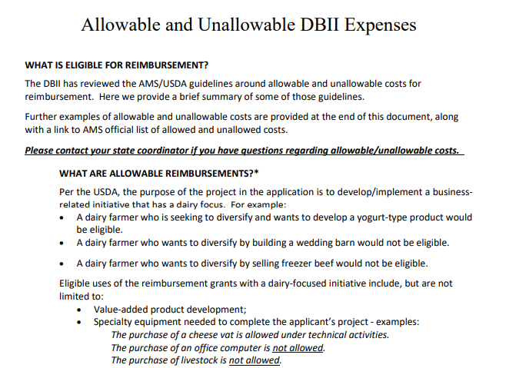
Allowable and Unallowable Expenses
https://www.ams.usda.gov/sites/default/files/media/AMSGrantsTermsandConditions.pdf

Slide 16
Match Requirement
Applicants must provide a cash match of at least 25% of the requested grant funds. For instance, a grant application requesting $100,000 would require $25,000 in matching expenses. Please note that a 25% match on requested funds is the same as 20% of the total project cost. To illustrate this, we can see that $25,000 (the match) equals 25% of $100,000 (the request), and 20% of $125,000 (the total project cost). The match dollars must be allowable expenses.
SDBII Grant Funds
Your Cash Match
$1
25

Slide 17
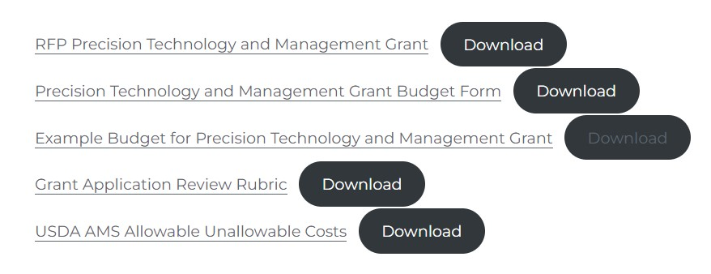
Grant Workbook Components
Please read the request for proposal IN FULL before starting your application.

Slide 18
Grant Workbook Access
Farm Infrastructure Improvement Grant
https://sdbii.tennessee.edu/farm-infrastructure-improvement-grant/
Precision Technology Investment Grant
https://sdbii.tennessee.edu/precision-technology-and-management-grant/

Slide 19
Scoring Criteria
The grant is scored out of a possible 100 points based on the following categories
Grant Application (5 possible points)
Goals Alignment (10 possible points)
Summary (20 possible points)
Work Plan (20 possible points)
Business Fundamentals (20 possible points)
Budget (20 possible points)
Other Considerations (5 possible points)

Slide 22
How do I access/submit the grant?
First read the grant RFP IN FULL
Log on to the grant portal and read each question
Reach out with questions to one of your state coordinators
Work in word or another word processing program (save as you go!)
Transfer text to the application portal when you are done
Upload budget, quotes, and other supplementary materials to the portal
Submit via the correct grant application portal
Applications must be received by: March 1st, 2024, at 5pm/ET

Slide 23
Grant Portal Access
Farm Infrastructure Improvement Grant
https://forms.gle/Hg47v64wU5LRtycq9
Precision Technology Investment Grant
https://forms.gle/jXXFSjbmibgEQbPb6

Slide 24
Unique Entity Identifier
Written Guide:
Click tab above the video: https://www.tn.gov/agriculture/topic/farm.html
Video Guide:
https://www.youtube.com/watch?v=0uv1YNAsINk

Slide 25
Who Can I Reach Out to for Help?
Program Contacts
Tennessee, Alabama, Florida, & Louisiana
Shep Stearns & Liz Eckelkamp: sdbiigrants@utk.edu
Kentucky, Arkansas, Virginia, & West Virginia
Jennifer Hickerson: j.hickersonkddc@gmail.com
North Carolina, South Carolina, Georgia, & Mississippi
Brittany Whitmire & Stephanie Ward: ncdairyextension@ncsu.edu

Slide 26
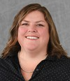
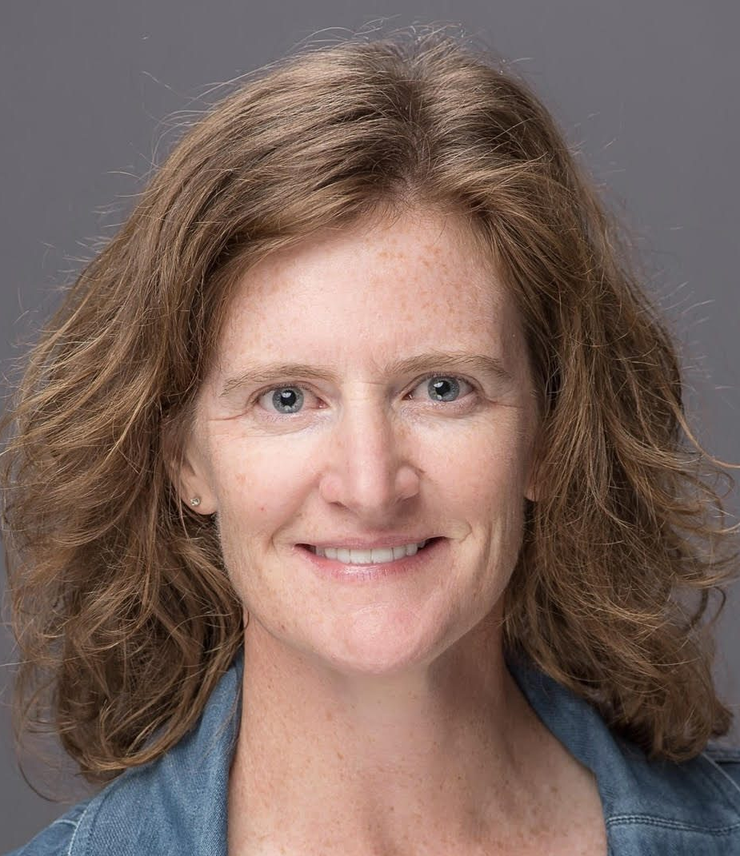
Team Members
Team of over 50 individuals across all disciplines (https://sdbii.tennessee.edu/our-team/)
Leadership Team:
North Carolina
Tennessee
Kentucky
Dr. Stephanie Ward
Brittany Whitmire
Jennifer Hickerson
Dana Weber, Shep Stearns, Dr. Liz Eckelkamp

Slide 27
Thank you! Questions?
Shep Stearns
sstearn1@utk.edu
(860) 595-6053
Southeast Value-Added Discussion Group
https://sdbii.tennessee.edu/

